Slide 1
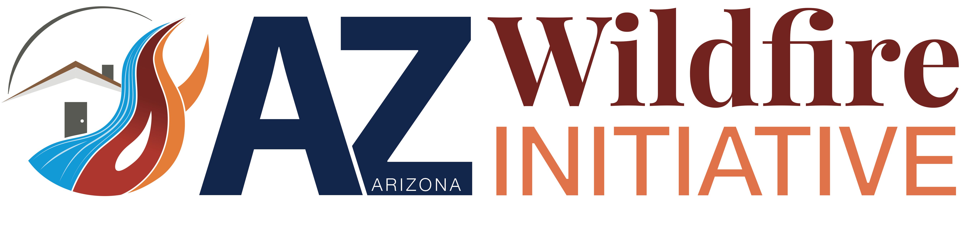

Business continuity workshop
Wildfire Preparedness
Presented by

Slide 2
Introduction
Notes:
Business owners invest a tremendous amount of time, money and resources to make their ventures successful, so it would seem natural for owners to take steps to protect those investments
How quickly a company can get back to business after a fire depends on emergency planning done today. Preparedness helps to minimize the negative impact of an unexpected event and limits the number of hasty decisions needing to be made in stressful coniditons. Planning enhances a company's ability to recover from financial losses, loss of market share, damages to equipment or products, and business interruption.
The goal for today is to have you all leave with a plan on how to be less disrupted by a wildfire, resume operations sooner, and recover faster. Today I hope to breaks down activities to make the process of planning for and recovering from a disaster manageable

Slide 3
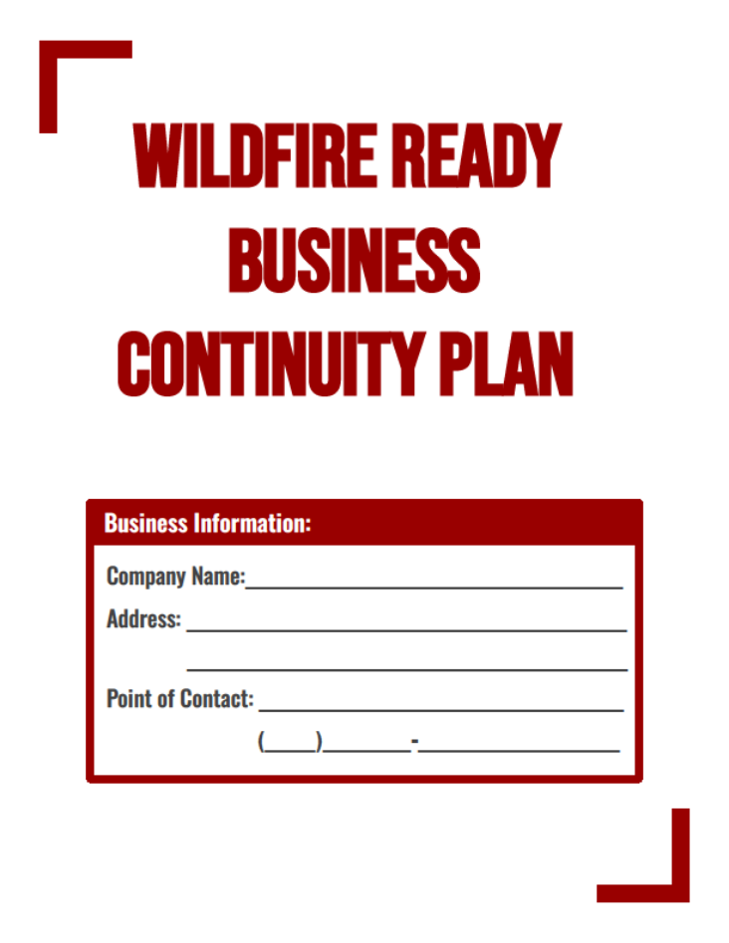
What is a business continuity Plan?
Business continuity plans are prevention and recovery systems for potential threats, such as natural disasters like wildfires.
The plan ensures that personnel and assets are protected and can function quickly in the event of a disaster.
They focus on the operations of the entire organization, its customer service and supply chain.
Plans are meant to be reviewed and kept up to date.
Notes:
Continuity plans are not disaster recovery plans. Continuity of operations planning involves looking at your business from inside and out to determine the people, resources and procedures that are absolutely essential to keep your operation running.

Slide 4
Know Your operations
Notes:
In this section we ae going to identify the business functions and processes that are critical to the survival of your business

Slide 5
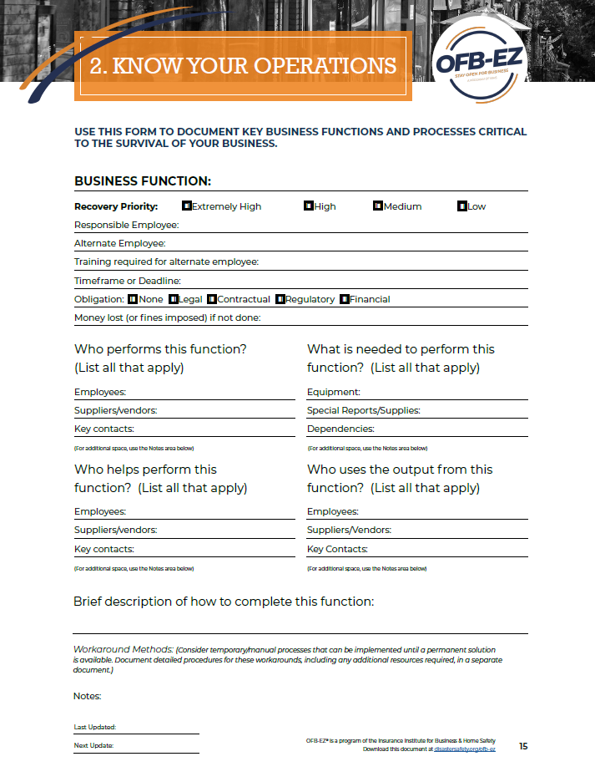
Identify Critical business functions and processes
Consider:
What is your main product/service?
What other business functions/processes do you perform to run your overall business?
What activities do employees perform on a daily, weekly, monthly, and annual basis or other special times of the year?
Prioritize these business functions in priority from extremely high to low.
Consider:
What are the consequences if the function can’t be performed?
Can your business survive without this function?
How much downtime can you tolerate for each function?
Notes:
CONTEXT: This activity assists in identifying functions and assets that are important to preserve and protect, and also prioritize post-disaster.
This goal of this planning to think about the consequences that would result if a particular business function could not be performed and determine whether there might be work-arounds to minimize disruption. This can inform potential recovery and resilience strategies that you can use to get your business operating quickly.
Question 2 can include things such as production/service delivery; manufacturing; customer service; sales/marketing; purchasing; accounting/finance; human resources; administration; and information technology?
Start with those most critical to keeping your business running if there is a disruption. For those functions that are less critical, think about how long the business can manage without conducting them.
Having redundancies in business functions can help you resume operations faster. For example, there may be a particular employee who is knowledgeable about executing a certain task; a redundancy would be to train another employee to learn the needed skill during periods of reduced activity. A good strategy is to eliminate any single point of failure, like having only one supplier for a critical item. Generating options in advance of a disaster can make the resumption of your business functions easier when something happens.

Slide 6
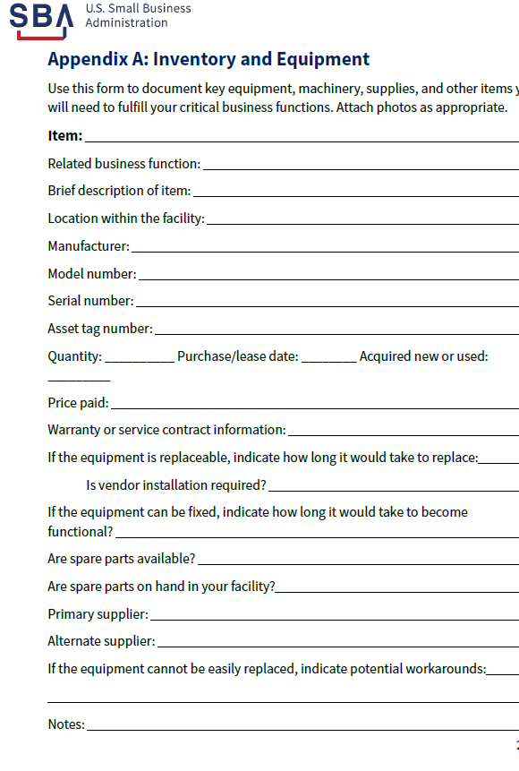
Identify equipment or machinery necessary to perform critical business functions
Determine how and where you might move these items to safeguard them from wildfire when there is advanced warning.
Consider:
Can the equipment be easily moved to an alternate location?
Notes:
Many successful businesses have specialized equipment, supplies or technology that can play a critical part in making their business operations effective. If these items failed or were unavailable, the business may have to restrict production of goods and services or be forced to shut down. Identifying critical equipment and inventory that is necessary for your business’ essential functions will enable you to determine the steps that will allow you to reestablish operations quickly should a disaster occur.
Save and store photos, purchase invoices, sales receipts, user guides, and warranty information and contract information with vendors in this BCP. You should be able to access this information at any time during the event. Put receipts into this binder as you purchase equipment.
This can also be documenting and building a folder of important documents (such as last year’s tax returns, business formation documents, EIN#, insurance policies and more) along with the username and password. Once this is complete, send yourself a copy at your personal and professional email addresses. Consider also sending this checklist to your back-up in the event you cannot operate your business after the disaster.

Slide 7

Identify available replacements or alternate options in case equipment becomes damaged or there is an event without advanced warning.
Consider:
Is the equipment customized or one-of-a-kind?
How long would it take to reorder?
Is the equipment functional or obsolete?
If obsolete, how long would it take to replace or get it functional?
Are there rental options to temporarily replace the equipment?
Can you outsource the end product if equipment cannot be substituted quickly?
Notes:
Decide in advance what you will do if your building is unusable.

Slide 8
Know Your Employees
Notes:
In this section we are going to go over how to gather essential contact information for your employees and the importance of identifying communication plans for evacuation and upon return

Slide 9
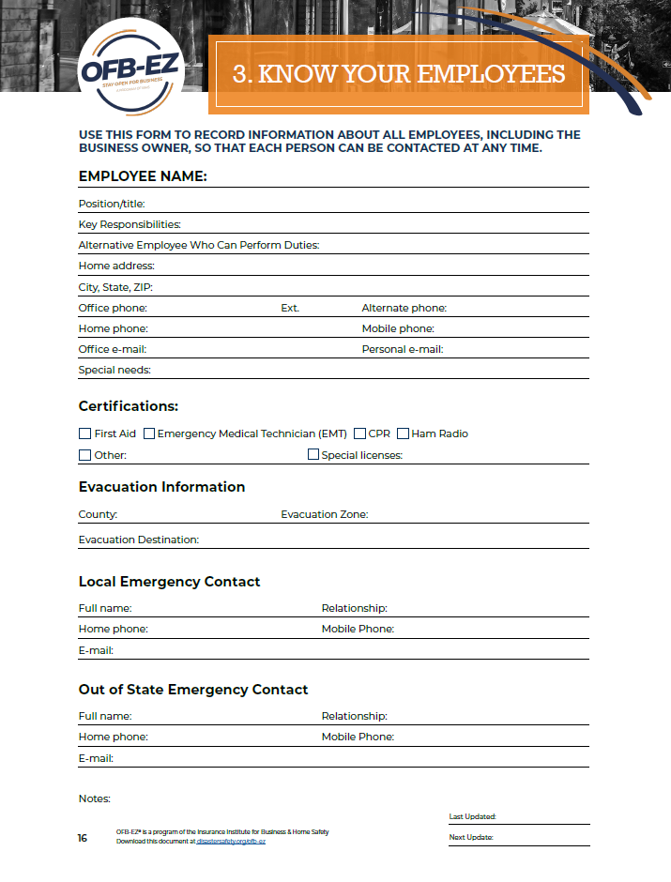
Know your employees form
Having up-to-date contact information is important for:
- Determining your employees’ safety
- Informing them about the status of operations and when, where, and how they should return to work
- Providing any additional instructions following a disruption
Notes:
Employees are one of a business’ most critical resources. Ensuring they understand what to do in an emergency is important to both their well-being and the ability of a business to survive disruption.
This form allows you to collect contact information for each employee
Talk to co-workers with disabilities. If you have employees with disabilities ask what assistance is needed. People with disabilities typically know what assistance they will need in an emergency.
Clarifying everyone’s role and training them in the protocols that should be followed before, during and after a disaster, can provide them with the information they need to react appropriately should your business be impacted
Identify who will shut down critical operations and lock the doors, if possible, during an evacuation

Slide 10

Other communication considerations
Designate a phone number and/or internet site where employees can get status updates and leave messages
Keep an up-to-date contact list of other relevant individuals including your insurance agent, accountant, and attorney
Promote family and individual preparedness among your co-workers
Notes:
Be prepared to provide employees with information on when, if and how to report to work following an emergency. Set up a telephone call tree, an e-mail alert or a call-in voice recording to communicate with employees in an emergency. Be clear on how their jobs may be affected.
It is vital to have an up-to-date contact list of employees and other relevant individuals such as your insurance agent, accountant, and attorney when a disaster happens.
Promote family and individual preparedness among your co-workers. Include emergency preparedness information during staff meetings, in newsletters, on company intranet, in periodic employee e-mails and through other internal communications tools. Encouraging employees to prepare for emergencies helps individuals and families minimize the impact a disaster may have on their lives. In the event of a disaster, employees will be able to re-establish routines faster and the company as a whole will be able to recover more quickly.
Staff may need to evacuate even if business isn't in zone. Have a plan even if threats aren't direct to business

Slide 11
Know Your finances

Slide 12
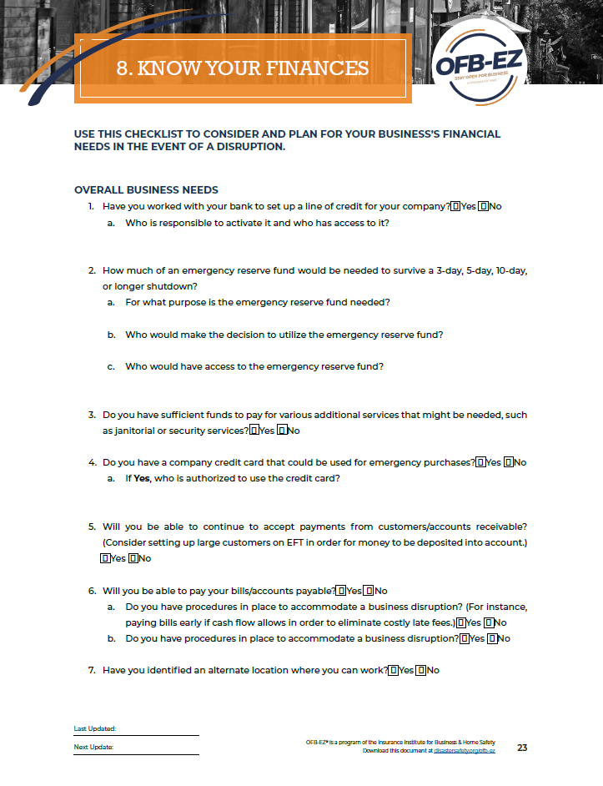
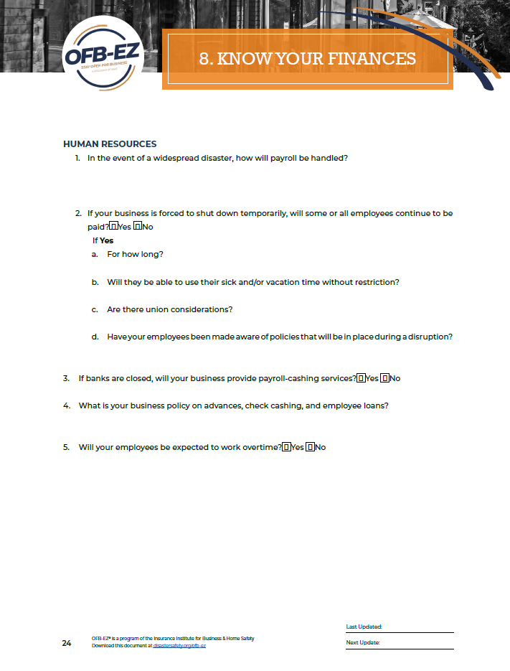
Emergency Financial Planning
Start an emergency reserve fund
Get a credit card or establish a line of credit
Identify expenses that must be paid
Consider creating a policy regarding payroll during or after a disaster
Notes:
Preparing your business financially now so it is ready to respond, recover, and continue operating when a business disruption occurs is just as critical as knowing exactly what to do when disaster strikes.
Start an emergency reserve fund.
Consider recovery costs, temporary accommodations, travel expenses, and other potential needs. You may need to purchase supplies or equipment or relocate your business temporarily. It might be a good idea to set aside some emergency cash such as 3-12 months of emergency funds or consider a line of credit. Cash during an emergency is recommended, especially in scenarios when the power may go out for long periods of time forcing business to be conducted on a cash-only basis.
Get a credit card or establish a line of credit.
Identify financial obligations and expenses that must be paid.
Don’t assume that because your area was hit by a disaster that your suppliers, vendors, and creditors are aware of the situation and are granting extensions. Items such as mortgage, lease, or rental payments may still be required. Talk with your creditors, suppliers, and landlord about potentially having an extension to pay bills should a disaster occur
Consider creating a policy regarding payroll during and after a disaster.
Payroll is often overlooked in business continuity planning. Don’t expect employees to continue working without pay during or after a disaster. Be sure employees are aware of your payroll continuity plans ahead of time so they can plan for their personal financial obligations. Talk with your payroll processor about setting up an automatic payroll system.. Consider adding liability insurance and a section where the insurance provider will carry your payroll for 6-8 weeks post-disaster or up to 90 days if the deductible fits your budget.

Slide 13
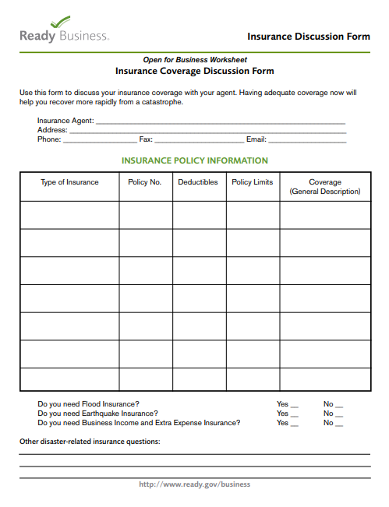
Evaluate your insurance
Meet regularly with your insurance agent/broker
Make sure your coverage is up to date
Understand what your policy covers, what it doesn’t, deductibles and limits, and how to file a claim
Discuss the types of insurance coverages available to you as business owners
Notes:
It is important to get adequate insurance for your place of business, your contents and inventory, and/or your production processes.
Also discuss the types of insurance coverages available to you such as business owners, business income/business interruption, contingent business income, extra expense insurance, loss of key personnel, and many others.
Extra expense provides coverage for the extra expenses incurred, such as temporary relocation or leasing of business equipment and payroll to avoid or minimize the suspension of operations during the time that repairs are being completed to the normal place of business.
Business income provides coverage for lost revenue and normal operating expenses if the place of business becomes uninhabitable after a loss during the time repairs are being made.
Ordinance or law provides coverage to rebuild or repair the building in compliance with the most recent local building codes

Slide 14

If you lease your workspace…
Decisions about reopening the building after a disaster may be made by the building's owner without your input.
Familiarize yourself with your lease agreement and any provisions concerning post-disaster access to the premises and renovations.
Notes:
It could be beneficial to establish a rapport with the owner to have a say in these decisions. Also if possible, negotiate terms for repairs in the event of a disaster or at least understand what you are/are not responsible for.

Slide 15
Know where to go for help

Slide 16

Small Business Administration
SBA’s disaster assistance helps businesses recover from DECLARED DISASTERS
Types of disaster loans:
Physical disaster loans
Mitigation assistance
Economic injury disaster loans
Check https://lending.sba.gov/search-disaster/ to confirm if SBA issued a disaster declaration for your area.
Notes:
Small Business Administration’s (SBA’s) post-disaster lending programs that can help you and your business when you are impacted by a disaster
Physical damage loans
are intended to replace damaged business property or restore its pre-disaster condition. Under this loan no upgrades or additions can be included unless required by local building codes, however the mitigation option can be used for resilient upgrades. Funds can cover disaster losses not fully covered by insurance. Up to $2,000,000 can be borrowed.
Loan proceeds may be used for the repair or replacement of the following:
Real property
Machinery
Equipment
Fixtures
Inventory
Leasehold improvements
Mitigation assistance
Expanded funding to make improvements to eliminate future damage. SBA also offers a mitigation option as part of the post-disaster loan program that enables a property owner to increase their physical disaster loan by up to 20 percent of the verified loss (or a maximum of $500,000) to pay for interventions that will make a property more resilient in the future.
Economic Injury Disaster Loans
can help meet financial obligations and operating expenses that could have been met had the disaster not occurred. The loan amount is based on economic injury and financial needs and is not to exceed $2,000,000
This QR code will take you to SBA.gov/disaster to learn more about how SBA offers low-interest disaster loans to homeowners, renters, businesses, and most non-profits that have been impacted by declared disasters.

Slide 17


Sba Resource partners
SCORE
SMALL BUSINESS DEVELOPMENT CENTERS (SBCDs)
Notes:
SCORE and SBDCs can help you apply for disaster loans and can advise you on other aspects of the recovery process as you get your business back up and running

Slide 18

Disaster Help Desk For Business
The Disaster Help Desk provides one-on-one expert assistance to small business owners before, during, and after a disaster strikes
Contact them today by dialing 1-888-MY-BIZ-HELP (1-888-692-4943)
Notes:
The Disaster Help Desk assists small businesses with disaster readiness, relief, and long-term recovery.
Disaster ReadinessLearn tips to prepare for disasters of all kinds, such as wildfires.
Immediate ReliefAccess information and resources available in the immediate aftermath of a disaster, including federal assistance.
Long-Term RecoveryGet advice on how to rebuild and sustain your business after a disaster.
The Disaster Help Desk team is connected to a vast network of disaster-assistance providers, including the Small Business Administration (SBA), the Federal Emergency Management Association (FEMA), and local/regional emergency management associations. They provide on-the-ground coordination of information among businesses, local chambers of commerce, NGOs, government responders, and disaster recovery specialists.

Slide 19
Know What you can do now

Slide 20
Preparing your business and employees
For your employees
Incorporate emergency planning or procedures into staff employees and new employee onboarding
Advise employees to keep copies of important document at work in case they need to evacuate without being able to go home
For your business
Consider landscaping and retrofitting options that make your property more fire-resistant
Notes:
If there is space at your workplace, also consider having employees prepare disaster supplies of a go kit to store at work.

Slide 21
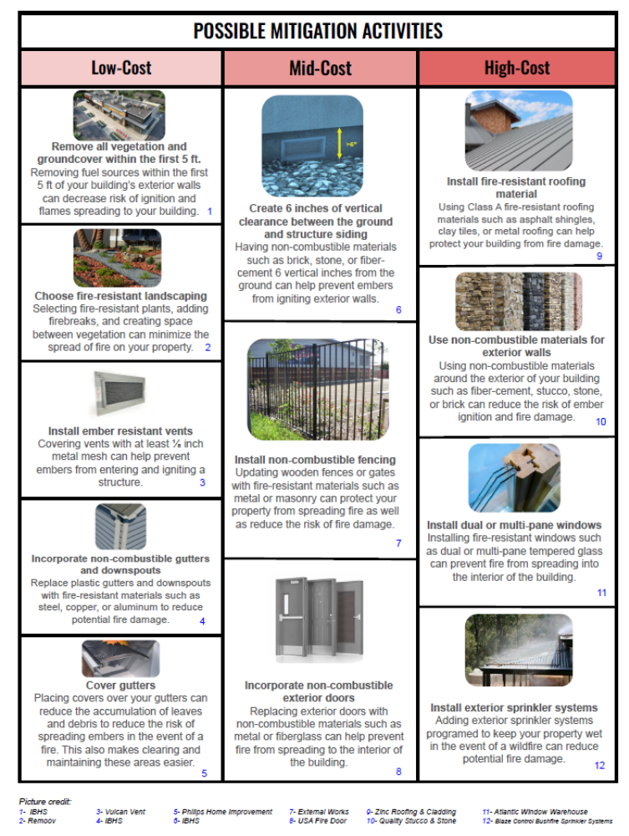
Mitigating Wildfire Risk
The Insurance Institute for Business and Home Safety (IBHS) and the National Association of Commissioners note that structural modifications can reduce wildfire risk up to 40%, and structural and vegetation modifications combined can reduce wildfire risk up to 75%.
Notes:
Mitigation reduces a property’s risk from future events and allows business owners and residents to return home more quickly, with less damage, after an event. Mitigation efforts of any kind against future disasters often provide positive benefits over time. While it may involve an initial investment, mitigation pays off in the long run.

Slide 22
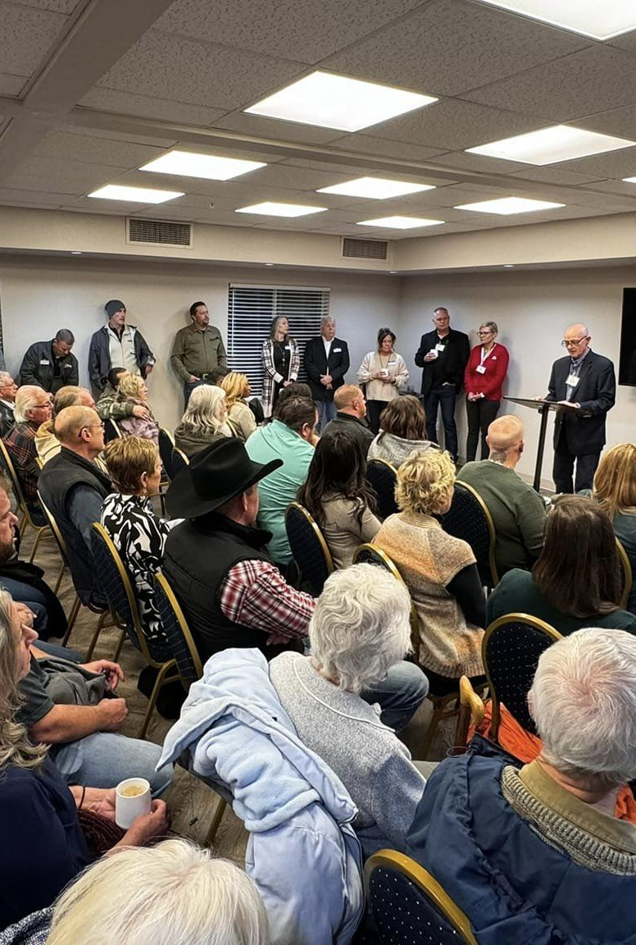
Communities Recover faster when businesses get back to business

